Slide 1


Digital Privacy: Password Manager
Team Merritt: Matthew and Michael Merritt

Slide 2


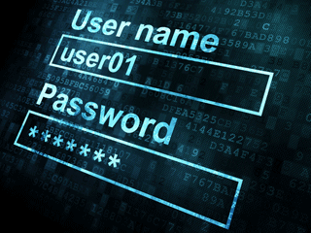
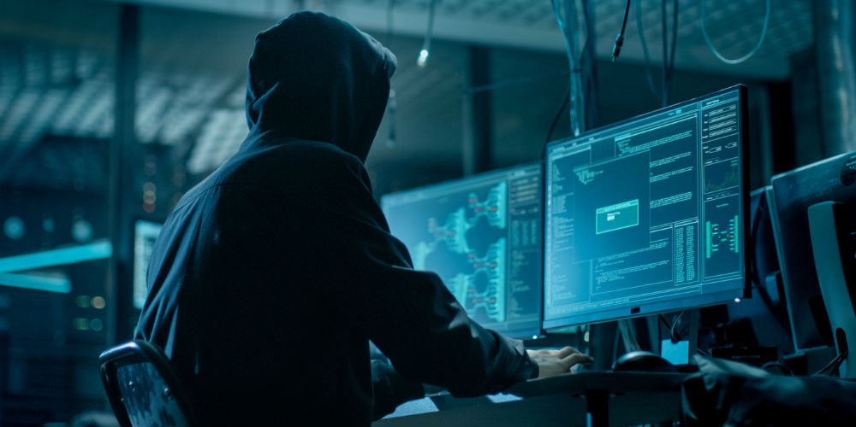
Why are Password Managers Important?
Using the Internet requires many accounts
Unique passwords are more secure but difficult to remember
Password managers let you make unique passwords without forgetting them

Slide 3

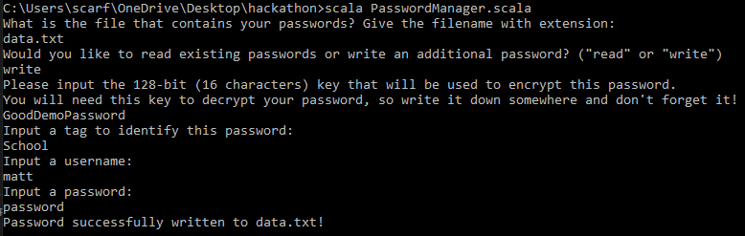
Our Program
Written in Scala
  Support for Java libraries and packages
Simple application that runs in a terminal
Can read and write information to text files
Data is stored using 128-bit AES encryption

Slide 4
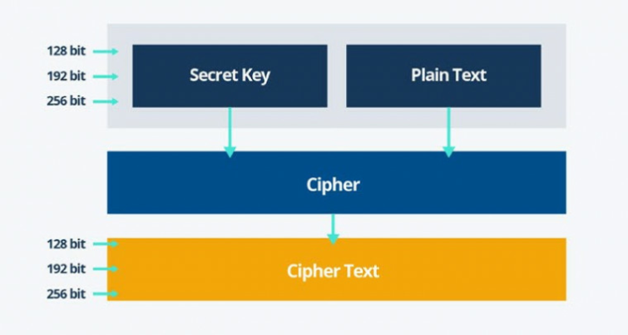
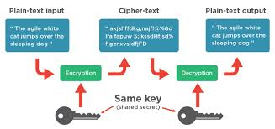

Implementing AES Encryption
We used 128-bit AES encryption because it is difficult to brute force
To implement AES encryption in Scala, we used features from a Java package
  Javax.crypto
    Javax.crypto.Cipher
    Javax.crypto.SecretKey

